Slide 1

Saudi Digital Bank
Waad Turki Alharbi | 2006198 Ghada Eisa Alsulami | 1905190 Sarah Abdulhadi Aljohani | 1906525 Instructor: dr. Hana Namankani
6/11/2022

Slide 2
Table of Contents
01
02
03
04
05
06
Introduction
Purpose of the Project
Goals and Objectives of the Project
Project Charter
& Scope Statement
Work Breakdown Structure (WBS)
Detailed project schedule (MS project)

Slide 3
Introduction
The emergence of technology has contributed to increasing human interaction with data, specifically financial transactions. We need to ways help to pay in easy and inexpensive ways without the need to resort to the bank obtaining bank cards and making transfers manually which wastes time and cost when printing thousands of credit cards for thousands of people. STC PAY shortens the time and facilitates the payment and transfer processes. STC PAY provides an e-wallet service where people are allowed safely control their payments, and also allows individuals to transfer, receive and control all their money through one application only. There are many features that will mention in the next section.

Slide 4
Purpose of the project
STC pay helps people to easily buy, transfer, receive money, pay bills, or even take advantage of good offers from many companies. What makes it more unique is the money split feature which let people split the bills with three different options: split equally, customize, or percentage. What is more surprising is that it aids send gifts or transfer money by number or international transfer! Also, you can send to your friend or family member “I need help” within the app and he can send you money. There are many, many things, but we just mentioned here what will catch your eye.

Slide 5
Goals and Objectives of the Project

Slide 6
Goals
- Provide a variety of digital banking services.
- Provide a convenient and secure means of transferring and receiving payments.
- Increase customer satisfaction.
- Offer innovative solutions.
- Reduce dependency on cash.
- Provide a reliable and secure digital bank.

Slide 7
Objectives
Design a user-friendly and clear mobile app user interface.
Analysis of the risk, threats, and problems that may occur during the project management processes.
Offering multi-factor authentication to all users in order to verify their identity when login.
Offering digital cards along with physical cards.

Slide 8
Objectives
Enable customers to manage their finances by adding money and paying bills.
Analysis of the risk, threats, and problems that may occur during the project management processes.
Offers diverse transforming methods, such as transforming to contacts, and local and international banks.
Enable users to request money or send gifts to/from their friends and family member.

Slide 9
Scope Statement
A new database with the customer's bank account information will be needed for this project. We will require a database server that performs the user-requested services in order to store the data. Besides 5G, 4G, WI-FI, or any network modems, the project also requires a reliable link server to respond to the app and the devices.

Slide 10
Project Charter
Project Title: STC pay system software
Project Start Date: 30-10-2022
Project Finish Date: 29-03-2023
Budget Information: The total expense is 282,750,00 SAR. (Only to software part , other cost such as salaries the banks will take this responsibilities). Most of the costs will be incurred in the creation of a Database and design for the system. The rest of work will be for the execution phases.
Project Manager:
Ghada Eissa Alsulmi , (+966) 50 999 0008, Ghada_Eissa@gmail.com
Project Objectives:
Create and design a high-security banking payment system. Besides security, the system's most feature is the user's enabled to use his STC pay in everywhere so he can really depend on her than the other original card and with more feature such as split bills between friends in the same time or gift a friend in the application. Whenever the user uses the application he is simply, needs to enter the password and user name so he can access and use the features of the STC pay .

Slide 11
Project Charter
Main Project Success Criteria:
To make the project successful, the manager should ensure that the project should Meets The following quadruple constraints:
· Scope: Cover all the untraditionally features than the other credit card that supplied by local banks.
· Time: Finish the project within the estimated date of 29-03-2023.
· Cost: Finish the project without overrunning the estimated budget.
· Quality: Gain customer trust and satisfaction.
Approach:
· Obtaining approval from the Ministry of Interior to launch the project, means we need sensitive information about the user to make him access and use the application.
· Cooperation with local banks in the Kingdom of Saudi Arabia.
· Cooperation with the National Cybersecurity Authority.
· Cooperation with internationals/locals companies, stores and hospital so we can give the user of the STC pay system more offers and special discounts.
·

Slide 12
Project Charter
Continue for the Approach:
· Create a configurable user interface for the system in phones app.
· Create a database that contains all the bank's client information.
· System integration.
· Multi-test for software performance, quality, user friendly, and adaptability. As well as ensuring that the system is safe from hacks gaps.
· Deploy the system in app stores so the user can download it and start use it.
Train the working staff with the policies of the banks in Saudi Arabia so they can so a system with government standard
·

Slide 13
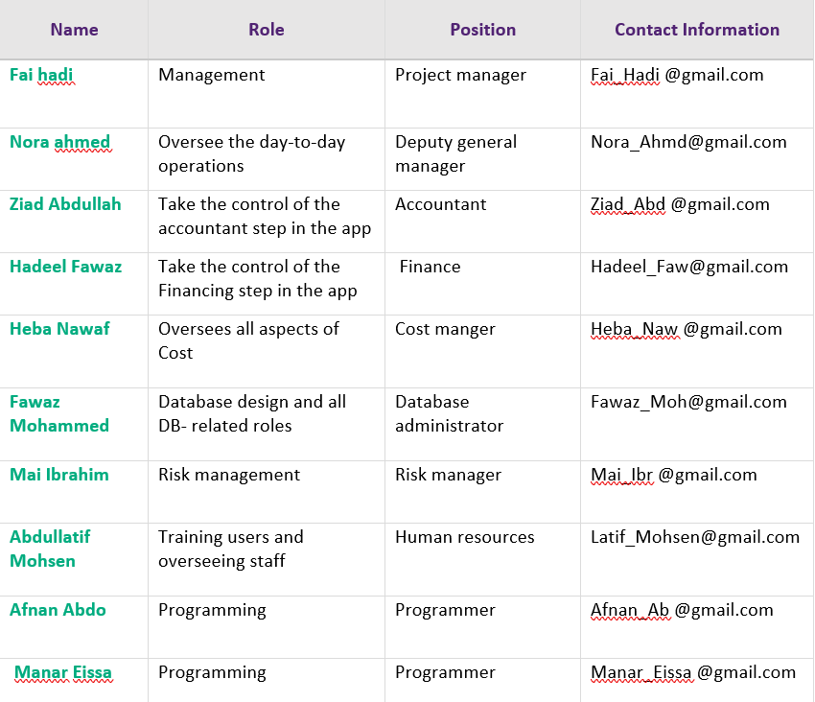
Roles and Responsibilities

Slide 14
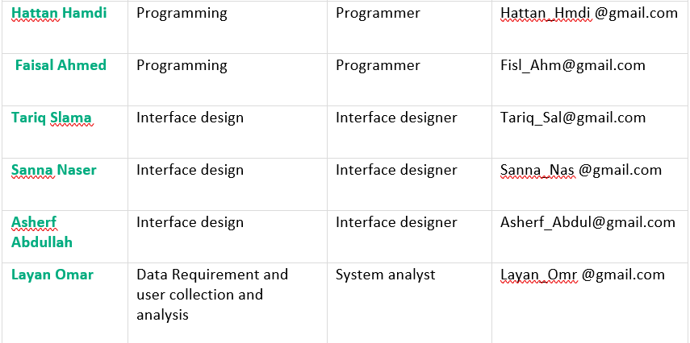
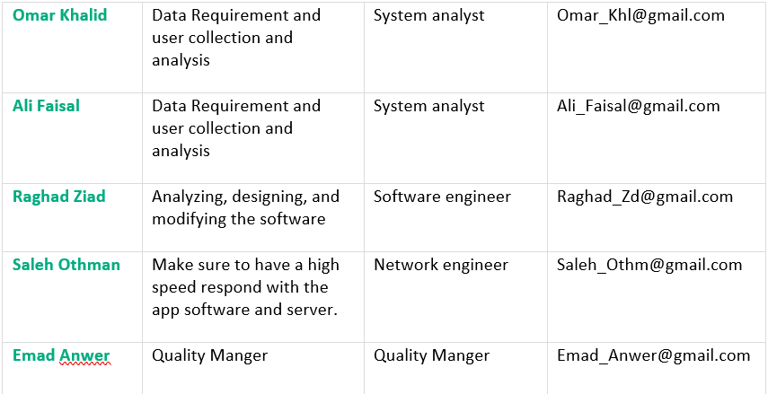
Roles and Responsibilities

Slide 15
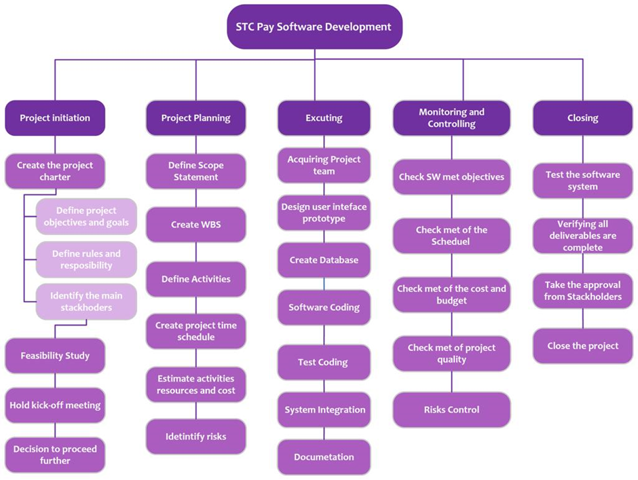
Work Breakdown Structure

Slide 16
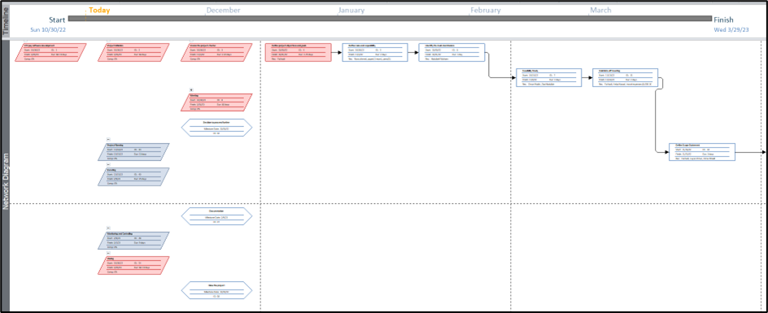
Precedence Diagram Method

Slide 17
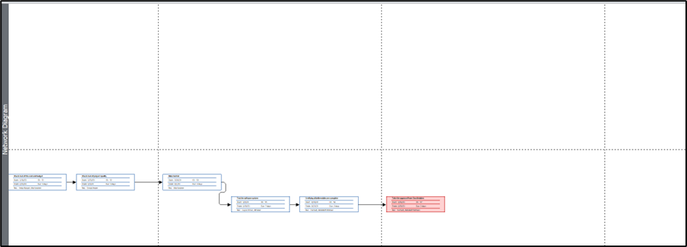
Precedence Diagram Method

Slide 18
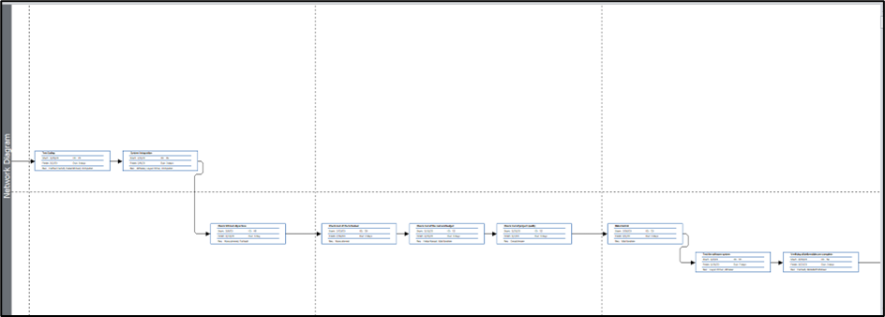
Precedence Diagram Method

Slide 19
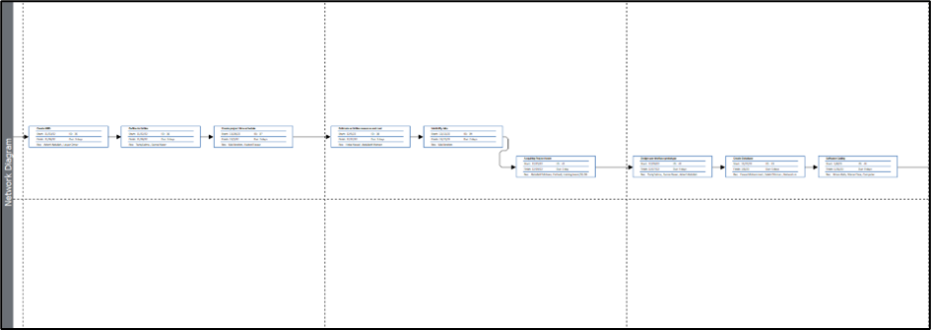
Precedence Diagram Method

Slide 20
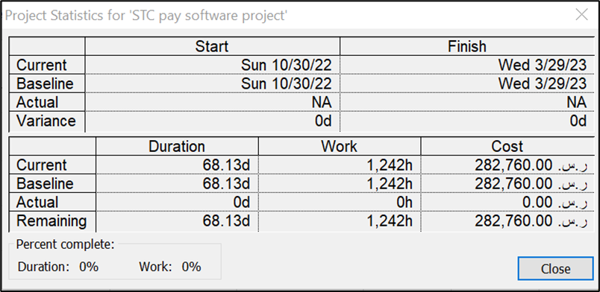
Project Cost Estimation

Slide 21
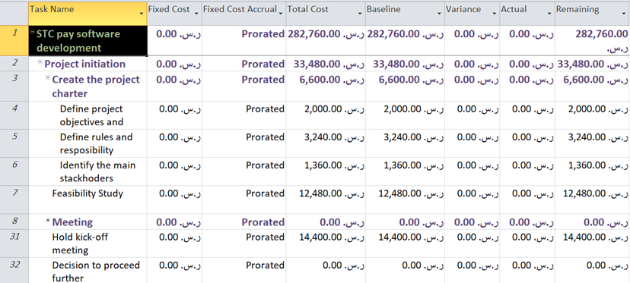
Project Cost Estimation

Slide 22
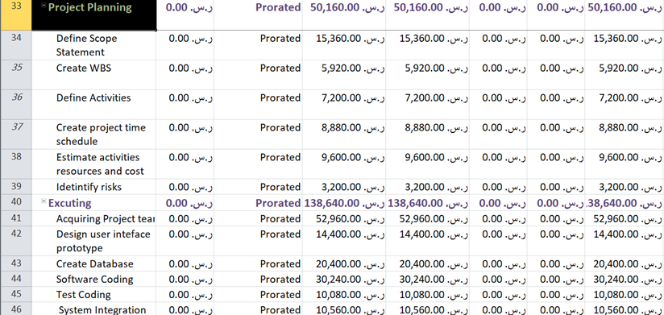
Project Cost Estimation

Slide 23
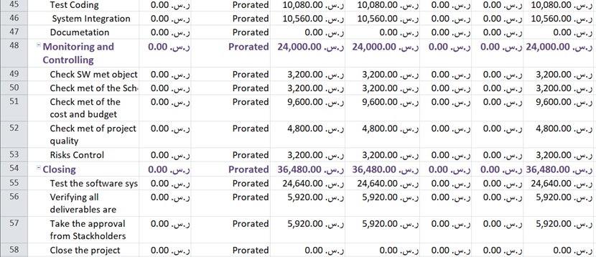
Project Cost Estimation

Slide 24
Staffing Procedure and Plan (HR Management)
Estimating the types and number of employees needed for the project.
Design a recruitment advertisement for the available jobs, including a description of the required skills and experience.
Post the recruitment advertisement through social media, newspapers, and Linkedin.
Select suitable candidates for various jobs by evaluating the candidates’ applications, interviews, and employment tests.
Place the new employee in the right position by training them if needed or transferring to some other job.
Introducing new employees to the project scope and environment.

Slide 25
Practical Part

Slide 26
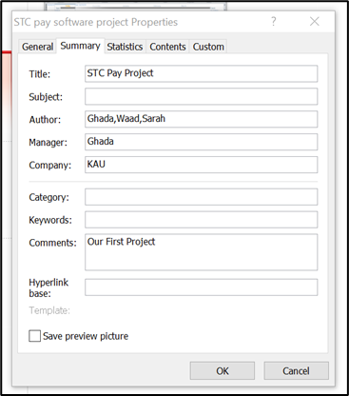
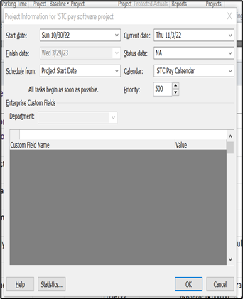
1- Enter general project information, such as the project name and start date.

Slide 27
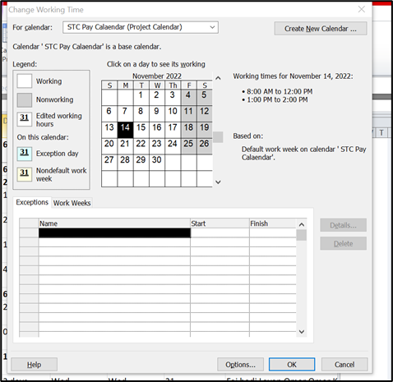
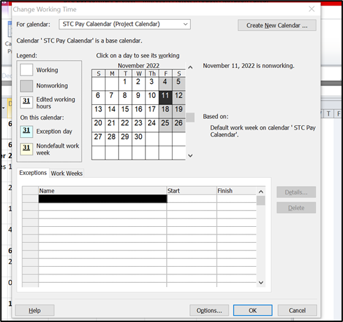
2- Make calendar settings for your project based on your organization's work & nonwork days.

Slide 28
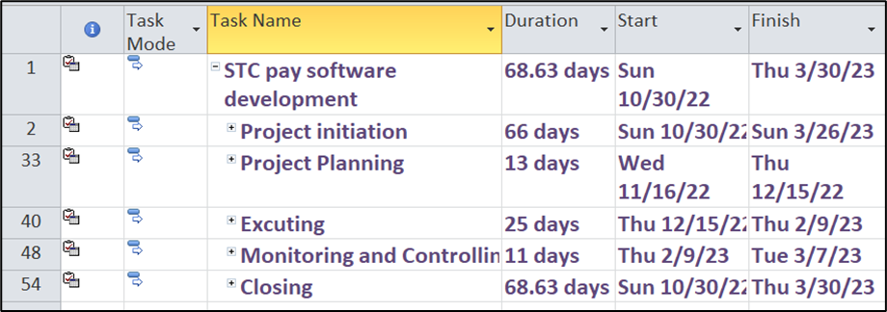
3- Enter the names of summary tasks (Phases)

Slide 29
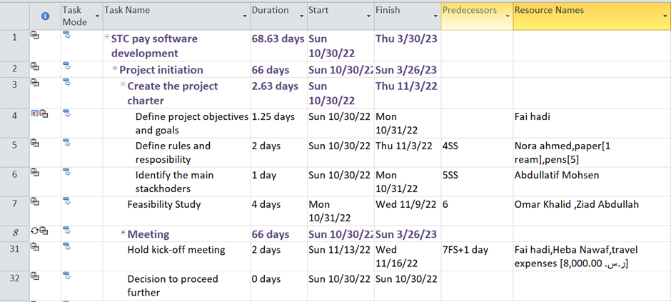
4- Enter the names of subtasks
5- Set the tasks duration

Slide 30
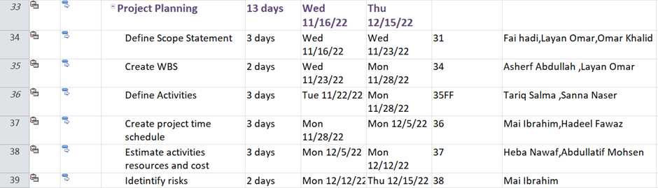
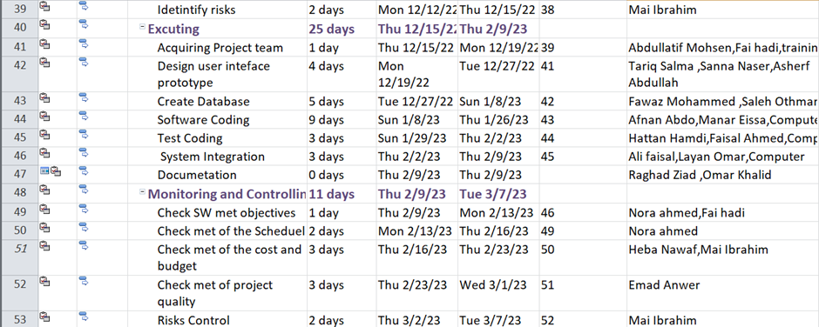

Slide 31
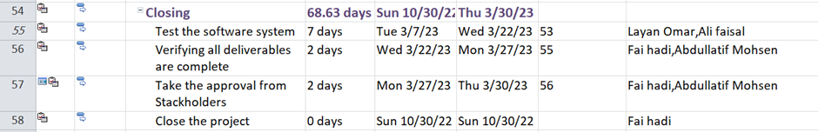

Slide 32
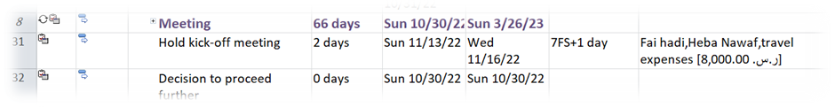
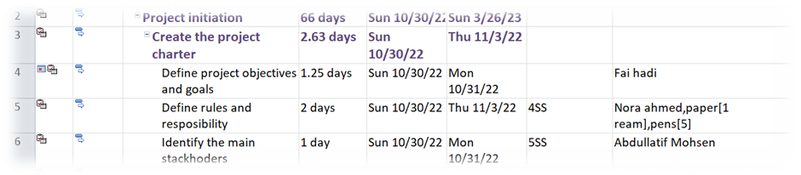
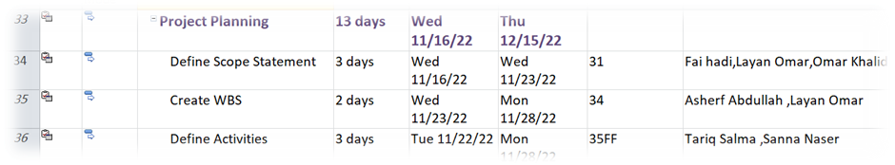
6- Configure the relationships between subtasks (at least 2 types)
FS
SS
FF

Slide 33
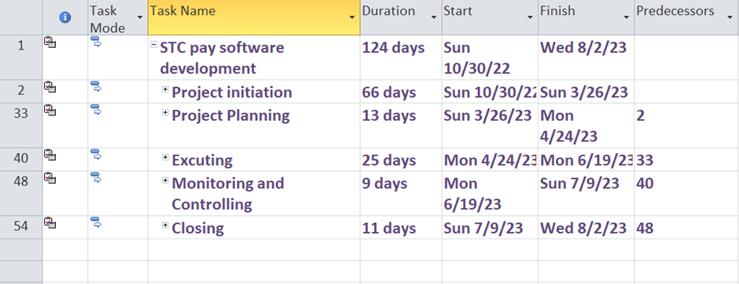
7- Configure the relationships between the summary task

Slide 34
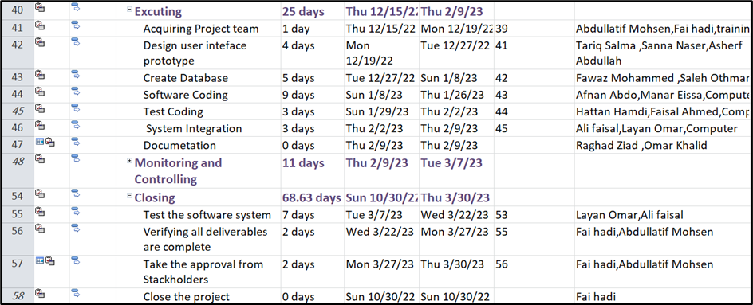
8- The project should contain some Milestones (at least 2 milestones)

Slide 35
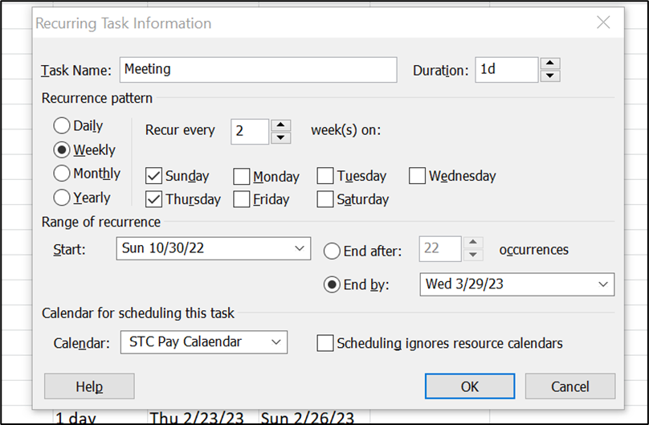
9- The project should contain a recurring task that should be repeated once a week on Monday until the finish date

Slide 36
10- The project should contain all 3 types (work, material, and cost) of resources and enter all their information in the resource sheet.

Slide 37
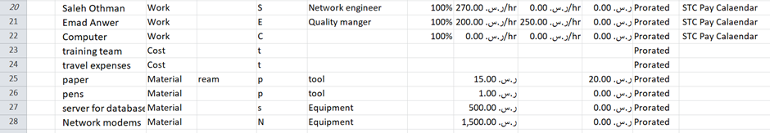
10- The project should contain all 3 types (work, material, and cost) of resources and enter all their information in the resource sheet.

Slide 38
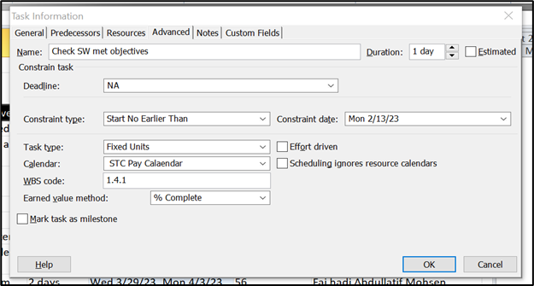
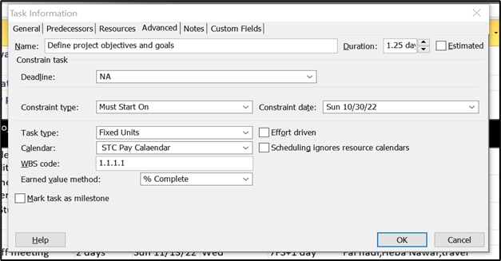
11- At least one task has a semi-flexible constraint, and another task has an inflexible constraint.

Slide 39
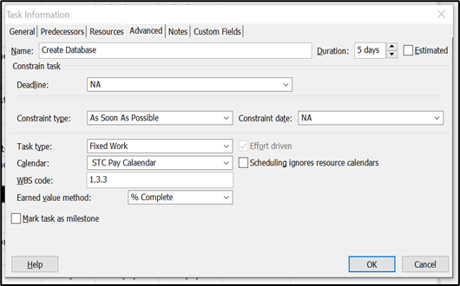
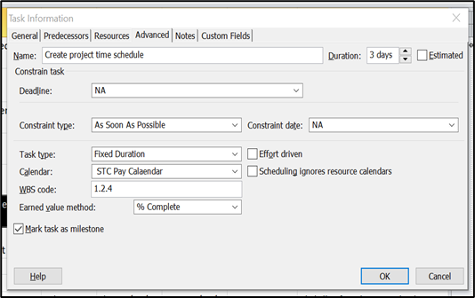
12-Set the type of one task as fixed duration and the other task as fixed work.

Slide 40
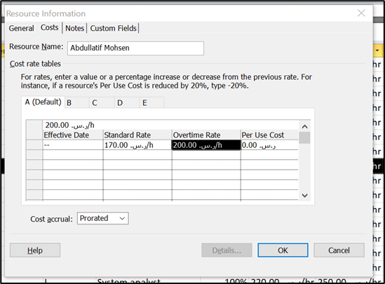
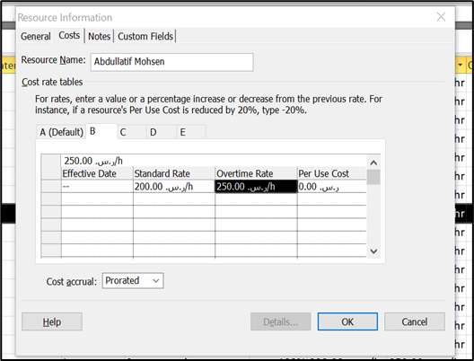
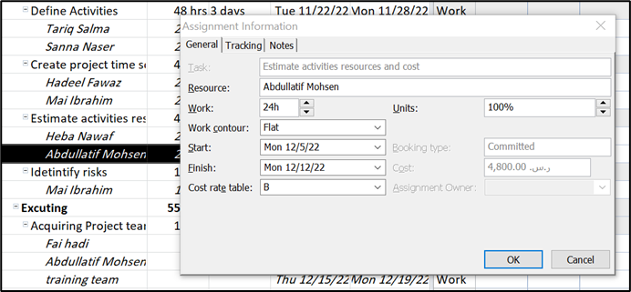
13- At least one person in your resource has a multiple pay rate depending on the task and you should attach these different pay rates to his tasks.

Slide 41
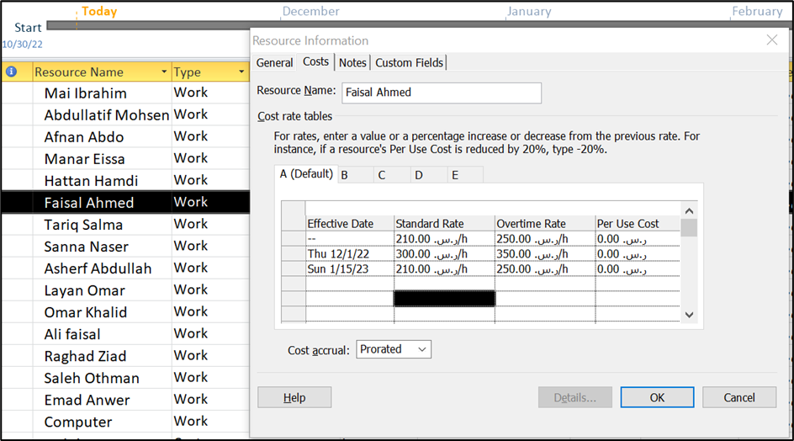
14- At least one person resource has a multiple pay rate depending on time.

Slide 42
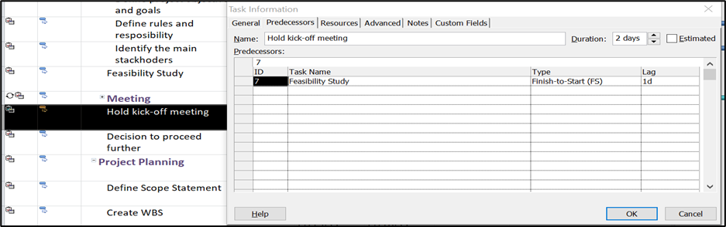
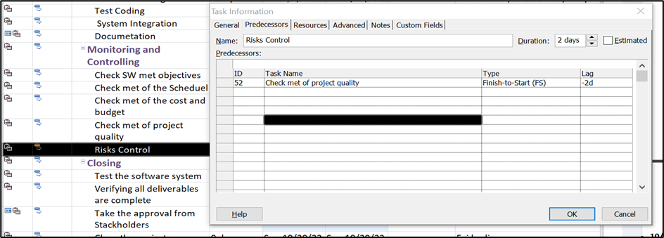
15- At least one task has a lead, and another task has a lag time.

Slide 43
Thank you for listening

Slide 44
References
Giraud, A. (2022, October 27). تطبيق ياخذك أبعد. Stc Pay. https://stcpay.com.sa/ar/

